Slide 1
Principal Component Regression (PCR)

Slide 2
Contents
Multiple Linear Regression-Quick Recap
The Problem of Multicollinearity
Principal Component Analysis – General Approach
Principal Component Regression (PCR)
Introduction
Statistical Model
PCR in Python

Slide 3
Multiple Linear Regression: Statistical Model
$$Y= b_{0}+b_{1}X_{1}+b_{2}X_{2}+ … +b_{p}X_{p}+e$$
Where,
Y : Dependent Variable
X₁, X₂ ,…, X_{p} : Independent Variables
b₀, b₁ ,…, b_{p} : Parameters of Model
e : Random Error Component
Independent variables can either be Continuous or Categorical

Slide 4
Problem of Multicolinearity
if there is a strong linear relationship among independent variables.
Multicolinearity exists
Highly Unstable Model Parameters As standard errors of their estimates are inflated
Consequences
Model Fails to predict accurately out of sample Data
Multicolinearity is detected using Variance Inflation Factor, VIF
Tolerance = 1- R_{i}²
VIF = 1/Tolerance
where R_{i}² (R Squared) is obtained using regression of Xi on other independent variables
Any VIF > 5, indicates presence of multicollinearity

Slide 5
Multicollinearity – Remedial Measures
The problem of Multicollinearity can be solved by different approaches:
Drop one of the independent variables, which is explained by others
Use Principal Component Regression in case of severe Multicollinearity
Use Ridge Regression

Slide 6
Principal Component Regression
In Principal Component Regression,
Each PC is a linear combination of all X variables
Final model is expressed in terms of original independent variables for ease of interpretation
First k principal components are used as independent variables instead of original X variables

Slide 7
Principal Component Regression
Transformation into PCs
The original p variables are transformed into a new set of orthogonal or uncorrelated variables called “Principal Components “
In the second step, after elimination of the least important principal components, a multiple regression analysis of the response variable against the reduced set of principal components is performed using the OLS estimation
Regression Analysis
Back Transformation
In the third step, model equation is back transformed in terms of original variables.

Slide 8
PCR-Statistical Model
Model in terms of original X variables:
Model in terms of Principal Components:

Slide 9
Case Study
Background
Objective
Available Information
A company periodically records data for sales and expenses. The company wishes to model the relationship between its sales and sales related expenses and obtain predictions
To predict incremental sales based on planned sales related expenses
Sales is the Dependent Variable
Data available for 143 micro business zones
Expenditure towards advertisements and promotions in the current and previous months are Predictors

Slide 10
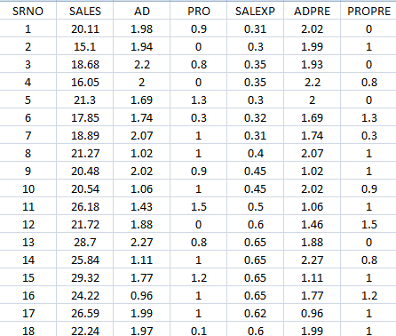
Data Snapshot
Dependent variable
Independent variables
Columns | Description | Type | Measurement | Possible values
SRNO | Serial Number | - | - | Intergers
SALES | Incremental Sales | Numerical | INR Million | positive value
AD | Current Advertising Expenses | Numerical | INR Million | positive value
PRO | Current Promotional Expenses | Numerical | INR Million | positive value
SALEXP | Misc. Sales Expenses | Numerical | INR Million | positive value
ADPRE | Previous Period’s Advertising Expenses | Numerical | INR Million | positive values
PROPRE | Previous Period’s Promotional Expenses | Numerical | INR Million | Positive value
Observations

Slide 11
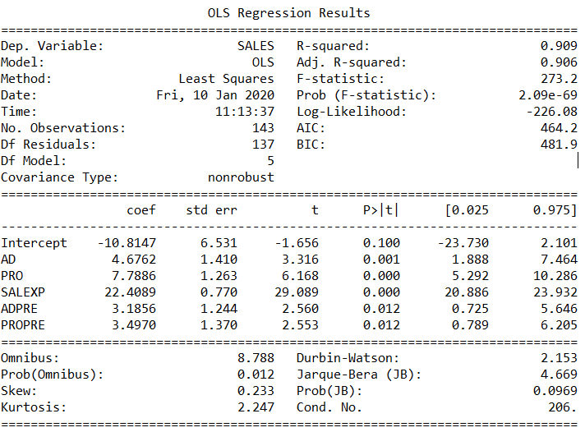
PCR in Python
# Importing csv file “pcrdata”
import pandas as pd salesdata = pd.read_csv('pcrdata.csv')
# Fit a Linear Model :
import statsmodels.formula.api as smf predsales=smf.ols('SALES~AD+PRO+SALEXP+ADPRE+PROPRE', data=salesdata).fit() predsales.summary()
smf.ols() fits a linear regression model.
summary() generates model summary.
# Output:
Interpretation:
Multiple R-Squared is 0.909, showing model to be a good fit.

Slide 12
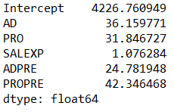
PCR in Python
# Checking for Multicollinearity
from patsy import dmatrices from statsmodels.stats.outliers_influence import variance_inflation_factor y, X = dmatrices('SALES~AD+PRO+SALEXP+ADPRE+PROPRE', data=salesdata, return_type="dataframe") vif = pd.Series([variance_inflation_factor(X.values, i)for i in range(X.shape[1])],index=X.columns) vif
# Output of VIF
patsy is a library that helps convert data frames into design matrices.
dmatrices Construct two design matrices given a formula_like and data. By convention, the first matrix is the "y" data, and the second is the "x" data.
variance_inflation_factor requires a design matrix as input to calculate vif.
variance_iinflation_factor() calculates VIFs.
Interpretation:
VIF values are very high (>5, except for SALEXP) indicating severe multicollinearity problem.

Slide 13
PCR in Python
# PCA in Python
# Subsetting data for PCA and using PCA function
from sklearn.decomposition import PCA from sklearn.preprocessing import scale salesdata2=salesdata.drop(['SRNO','SALES'], axis=1) standardisedX = scale(salesdata2) X = pd.DataFrame(standardisedX, index=salesdata2.index, columns=salesdata2.columns) pca = PCA().fit(X)
drop() is used to remove the columns from the data.
The data should be standardised using the function scale()

Slide 14
PCR in Python
# Summary of PCA
import numpy as np names = ["PC"+str(i) for i in range(1,6)] SD = list(np.std(pca.transform(X), axis=0)) VarProp = list(pca.explained_variance_ratio_) CumProp = [np.sum(pca.explained_variance_ratio_[:i]) for i in range(1,6)] summary = pd.DataFrame(list(zip(SD, VarProp, CumProp)), index=names, columns=['Standard Deviation','Proportion of Variance','Cumulative Proportion']) summary
Define names of columns as PC1,PC2 and so on.
Extract Standard Deviation and Proportion of variance explained. Define Cumulative proportion for the summary table
pca.transform(X) computes scores
Creates a dataframe of summary output

Slide 15
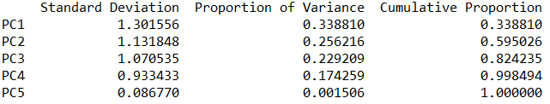
PCR in Python
# Output
Interpretation:
The first three principal components explain 82% of the variation in the data. Therefore, we will use 3 components in PCR

Slide 16
PCR in Python
# Import library hoggorm for PCR in Python
import hoggorm pcmodel = hoggorm.pcr.nipalsPCR(standardisedX, y) salesdata['pcrpred'] = pcmodel.Y_predCal()[3] salesdata.head()
pcr.nipalsPCR() in library hoggorm performs Principal Component
standardisedX is the X in the PCR model and y is object of dependent variable
[3] is the number of components to be included in the model,
.Y_predCal() is used to get predictions using PCR.

Slide 17
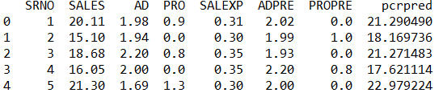
PCR in Python
# Output
pcrpred column gives the predicted values of SALES using PCR.

Slide 18
Comparing Linear Regression Model and PCR model on Test data
# Importing Test Data
salesdata_test = pd.read_csv('pcrdata_test.csv')
# Getting RMSE of PCR model
salesdata_test2=salesdata_test.drop(['SRNO','SALES'], axis=1) standardisedX2 = scale(salesdata_test2) salesdata_test['pcrpredict'] = pcmodel.Y_predict(standardisedX2, numComp=3) salesdata_test['pcrres'] = salesdata_test['SALES'] - salesdata_test['pcrpredict'] import math import statistics RMSE_pcr = math.sqrt(statistics.mean(salesdata_test['pcrres']**2))
RMSE_pcr stores RMSE value using PCR Model.
# Getting RMSE of linear regression model
salesdata_test['lmpred'] = predsales.predict(salesdata_test) salesdata_test['lmres'] = salesdata_test['SALES'] - salesdata_test['lmpred'] RMSE_lm= math.sqrt(statistics.mean(salesdata_test['lmres']**2))
RMSE_lm stores RMSE using normal regression

Slide 19
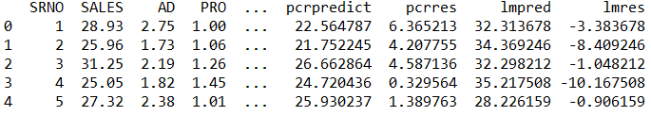
Comparing Linear Regression Model and PCR model on Test data
# Viewing data after adding predicted & residual variables
salesdata_test.head()
# Output
RMSE_lm [1] 9.111682179878775 RMSE_pcr [1] 3.0135616853589267
Interpretation:
RMSE using PCR is less than RMSE using linear regression, we may conclude that PCR model predicts SALES better than linear regression model when multicollinearity exists.

Slide 20
Quick Recap
Multiple Linear Regression and Multicollinearity
Fundamental assumption for building a good multiple linear regression model is to have non-correlated predictor variables.
However, highly correlated predictor variables is a very frequent phenomenon in real world analytics.
Principal Component Regression
Such severe multicolinearity can be effectively handled by combining the regression with Principal Component Analysis.
PCR is a three way process where the variables are first transformed to principal components, regression is run by considering these components as regressors and finally, they are transformed back to their original forms.
PCR in Python
pcr.nipalsPCR() function in library hoggorm performs PCR.

Slide 21
THANK YOU!

